Slide 1
Network : Internet Protocol (2)
Jae Hyeon Kim

Slide 2
Reference
William Stalling, Data and Computer Communications 10/E, Prentice Hall

Slide 3
Subnets and Subnet Masks
Aims to save the IP addresses by sharing an address with a set of physical networks
Allows arbitrary complexity within an organization
Insulate overall Internet from growth of network numbers and routing complexity
Site looks to rest of internet like single network
Each LAN assigned subnet number
Host portion of address partitioned into subnet # and host #
Local routers route within subnetted network
Subnet mask indicates which bits are subnet number and which are host number

Slide 4
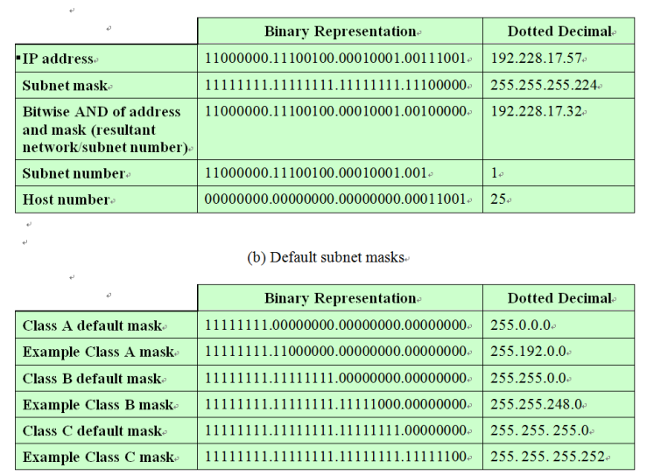
IP Addresses and Subnet Masks

Slide 5
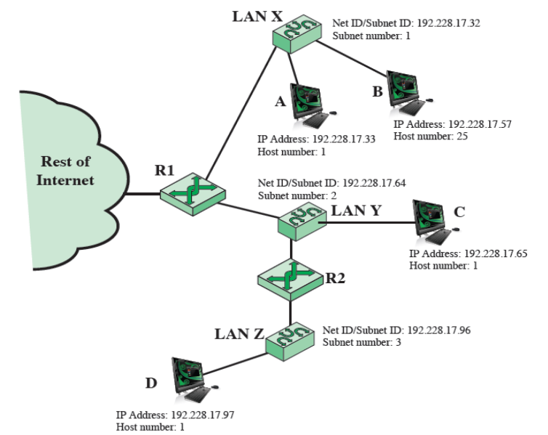
An Example : Routing Using Subnets

Slide 6
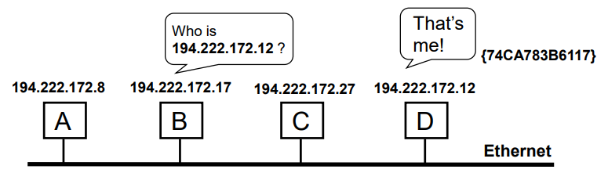
Mapping IP Addresses to the DL
Consider an Ethernet(IEEE802.3) LAN running IP
Recall data link layer has it’s own 48-bit addresses
Network layer provide it’s own 32-bit IP address space
Data link layer knows nothing about IP addresses
How do these two sets of addresses get mapped?
ARP(Address Resolution Protocol, RFC 826) build a query message and broadcast it
All hosts in the network receive it and one says “that’s me!”

Slide 7
Address Resolution Protocol (ARP)
ARP is a part of the physical network system
But it is not a part of the IP
ARP is a low-level protocol that hides the underlying network physical addressing
And permits a machine to assign an arbitrary IP address
Now, the broadcasting is too expensive, how can it be solved?
When a host receives an ARP reply, it saves the sender’s IP address and its physical address in its cache for successive lookups
Is it be possible more refinement?
The sender’s IP-to-physical address binding is included in every ARP broadcast; receivers update the binding in their cache

Slide 8
Table Driven IP Routing
IP routing employs an routing table on host and router
The routing table contains information about the possible destinations and how to reach them
IP consults the table to decide where to send the datagram
Then, what information should be kept in routing tables?
Minimal information principle : keep network prefix only
Information hiding principle : specifies one step along the path from the router to a destination
Default routing : if no route appears in the table, the routing routines send the datagram to a default router

Slide 9
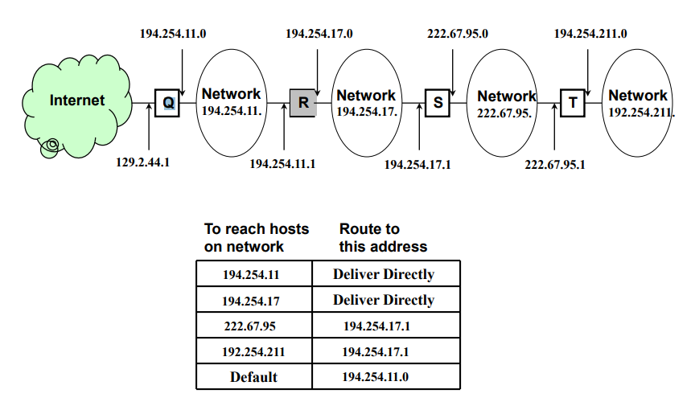
Table Driven IP Routing (An Example)

Slide 10
Routing Protocols in IPv4
IP routing is based on the destination network ID alone?
All IP traffic for a given network tales the same path regardless to the delay or throughput of physical network
Only the final router can determine if the destination exists or is operational, the router only can report the delivery to the sender
Each router routes traffic independently – someone should find out if two-way communication is always possible
IP routing selects the next hop to be sent the datagram
IP simply passes the datagram and the next hop IP address to the network interface software (so-called network driver)
The driver software responsible to bind the next hop IP address to a physical address, forms a frame, and sends it

Slide 11
Internet Control Message Protocol (ICMP)
RFC 792
Provides a means for transferring message from routers and other hosts to a host
Mainly provides feedback about problems
Datagram cannot reach its destination
Router does not have buffer capacity to forward
Router can send traffic on a shorter route
Encapsulated in IP datagram
Hence net reliable

Slide 12
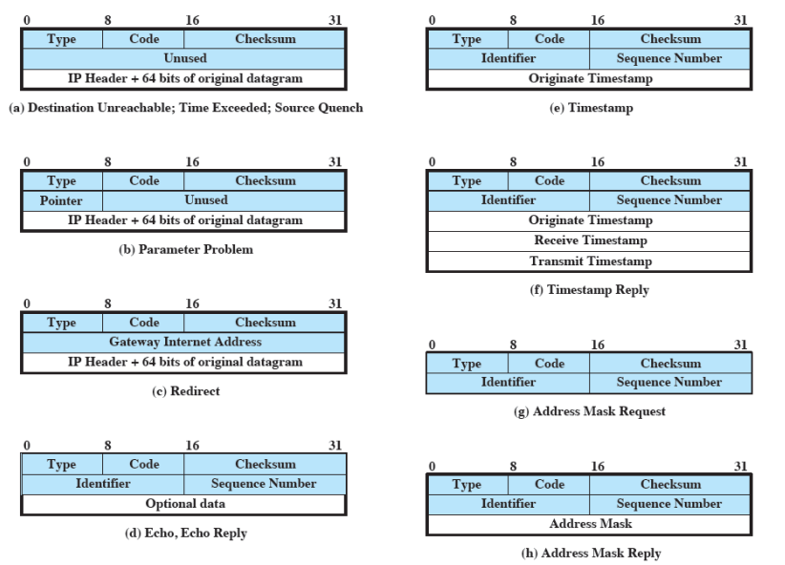
ICMP Message Format

Slide 13
Why Change IP?
Address space exhaustion
Two level addressing (network and host) wastes space
Network addresses used even if not connected to Internet
Growth of networks and the Internet
Single address per host
Requirement for new types of service
Address configuration
Routing flexibility
Traffic support
Security
mobility

Slide 14
IPv6 RFCs
IP versions
IP v1-3 defined and replaced
IP v4 - current version
IP v5 - streams protocol
IP v6 - replacement for IP v4 : during development it was called IPng(IP Next Generation)
RFC 1752 – recommendations for the IPng
Requirements
Addressing, routing security issues
RFC 2460 – overall specification
RFC 4291 – addressing structure

Slide 15
IPv6 Enhancements
Expanded address space
128 bit
Improved option mechanism
Separate optional headers between IPv6 header and transport layer header (most are not examined by intermediate routes)
Dynamic address assignment
Increased addressing flexibility
Anycast – delivered to one of a set of nodes
Support for resource allocation
Labeling of packets to particular traffic flow

Slide 16
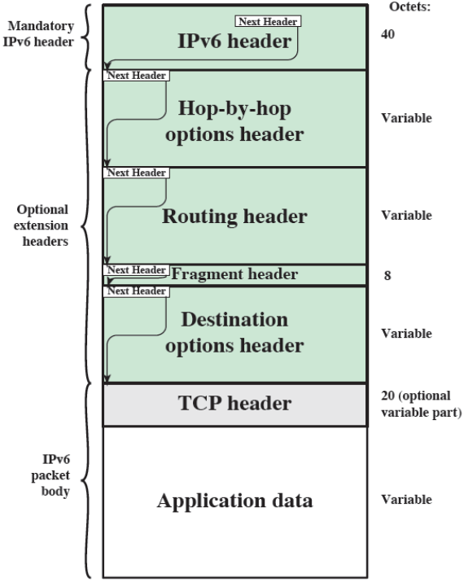
IPv6 Packet with Extension Headers

Slide 17
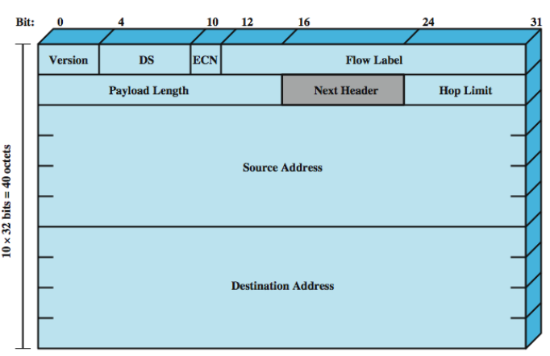
IPv6 Header

Slide 18
IPv6 Flow Label
Related sequence of packets
Needs a special handling for a specific packet
Identified by source and destination address + flow label
Router treats flow as sharing attributes
E.g. path, resource allocation, discard requirements, security
May treat flows differently
Buffer sizes, different forwarding precedence, different QoS
Flow requirements are defined prior to flow start and a unique flow level is assigned to the flow
Alternative to including all info in every header

Slide 19
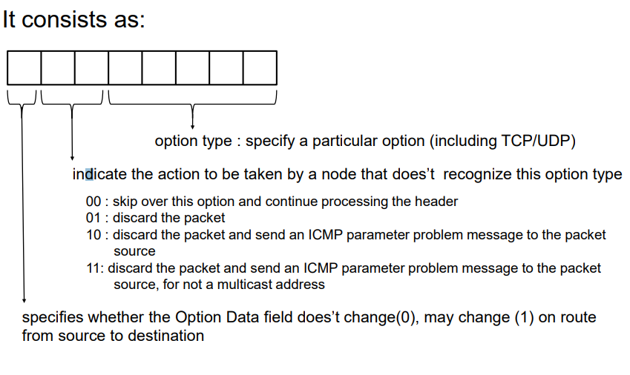
Next Header

Slide 20
IPv6 Addresses
128 bits long
Assigned to an interface rather than a host
Single interface may have multiple unicast addresses
Three types of address
Unicast : single interface
Anycast : set of interfaces (typically different nodes), delivered to any one interface, usually the “nearest”
Multicast : set of interfaces, delivered to all interfaces identified

Slide 21
Extension Headers
Hop-by-hop options
Require processing at each router
Routing options
Similar to v4 source routing
Fragmentation options
Only allowed at source, no fragmentation at intermediate routers
Authentication options
Encapsulating security payload
Destination options
Carries optional information for destination node

Slide 22
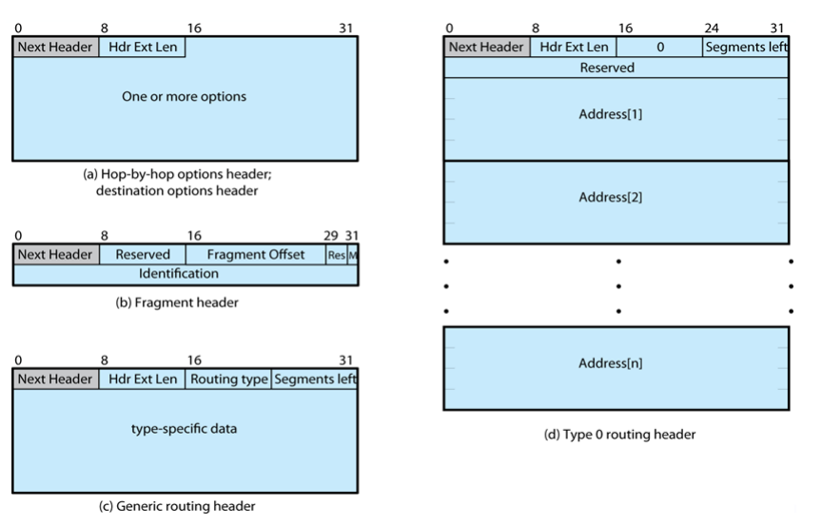
IPv6 Extension Headers

Slide 23
Virtual Private Network (VPN)
Set of computers interconnected using an unsecure network, as Internet
But they provide a secure channel between the organizations, much like as a private network
Using encryption & special protocols to provide security
Eavesdropping (cryptography)
Entry point for unauthorized users (authentication)
Proprietary solutions are problematical
Hence, develop the IPSec standard

Slide 24
IPSEC
RFC 1636 (1994) identified security need
Encryption & authentication to be IPv6
But designed also for use with current IPv4
Applications needing security include:
Branch office connectivity
Electronic commerce security
Benefits
Provides strong security for external traffic
Resistant to bypass
Can be transparent to applications as well as end users

Slide 25
IPSEC Function
Authentication header
For authentication only
Encapsulating Security Payload (ESP)
For combined authentication/encryption
A key exchange function
Manual or automated
VPNs usually need combined functions

Slide 26
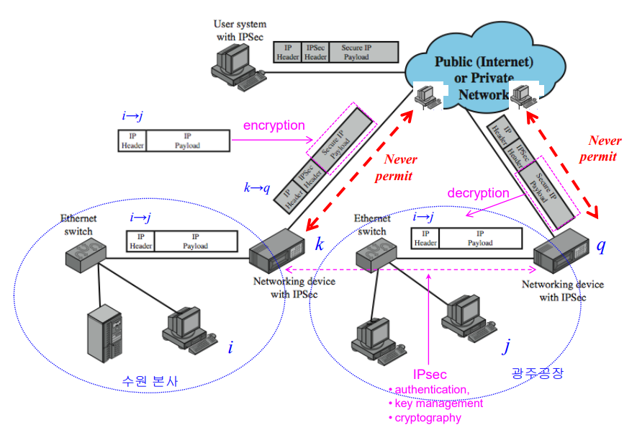
IPSEC Scenario : VPN

